Slide 1
CSE 417T Introduction to Machine Learning
Lecture 17 Instructor: Chien-Ju (CJ) Ho

Slide 2
Logistics
Homework 4 is due November 14 (Monday)
Keep track of your own late days
Gradescope doesn’t allow separate deadlines
Your submissions won’t be graded if you exceed the late-day limit
Midterm grades are posted on WebSTAC

Slide 3
Recap

Slide 4
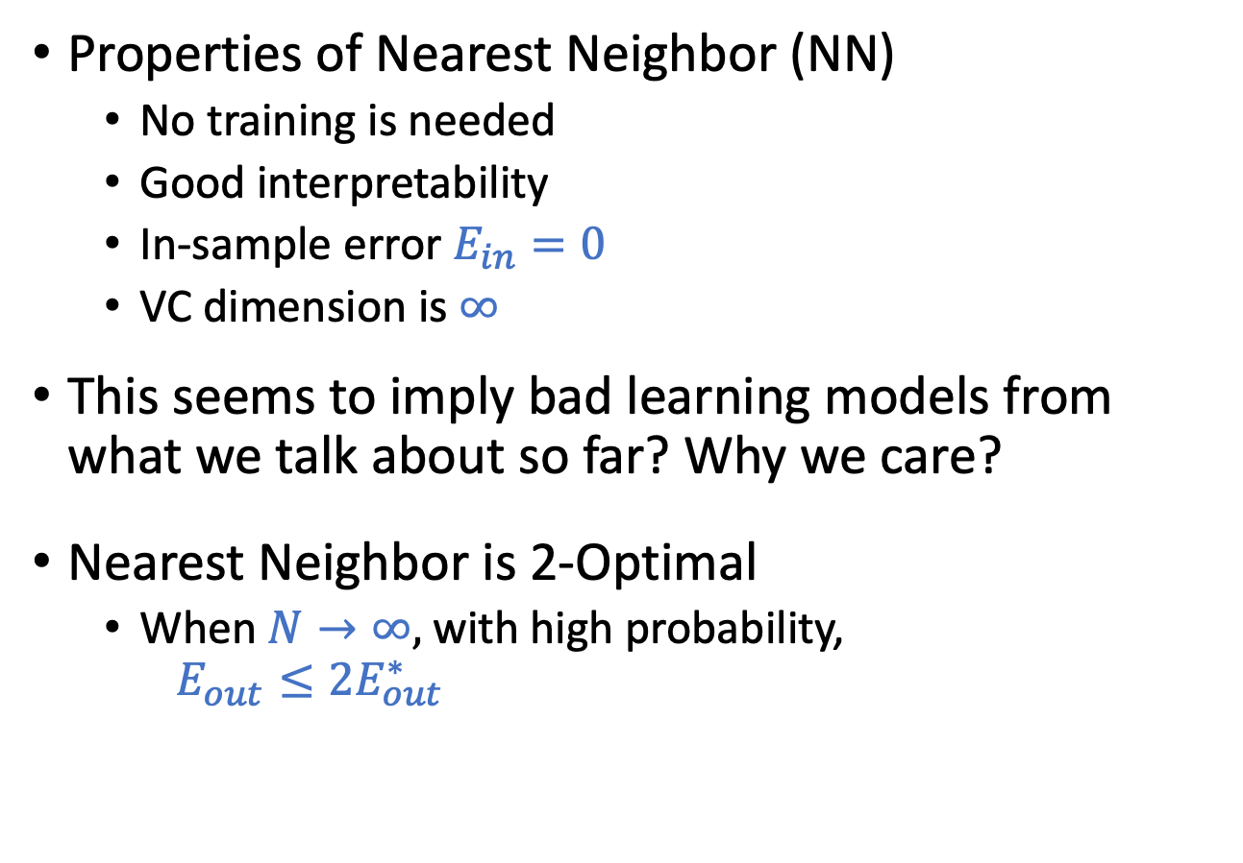
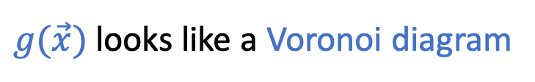
Nearest Neighbor
Properties of Nearest Neighbor (NN)
No training is needed
Good interpretability
In-sample error $E_{in}=0$
VC dimension is $∞$
This seems to imply bad learning models from what we talk about so far? Why we care?
Nearest Neighbor is 2-Optimal
When $N→∞,$ with high probability, $E_{out}≤2E_{out}^{∗}$
$g(\vec{x})$ looks like a Voronoi diagram

Slide 5
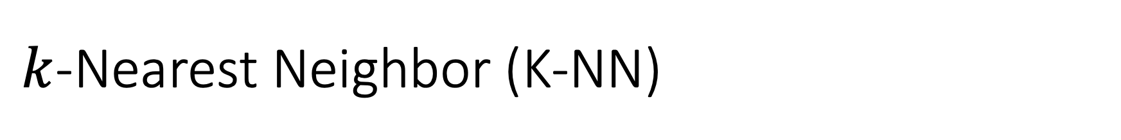
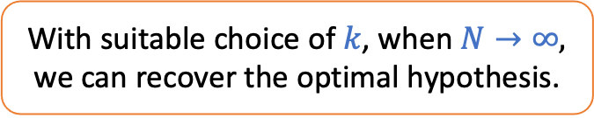
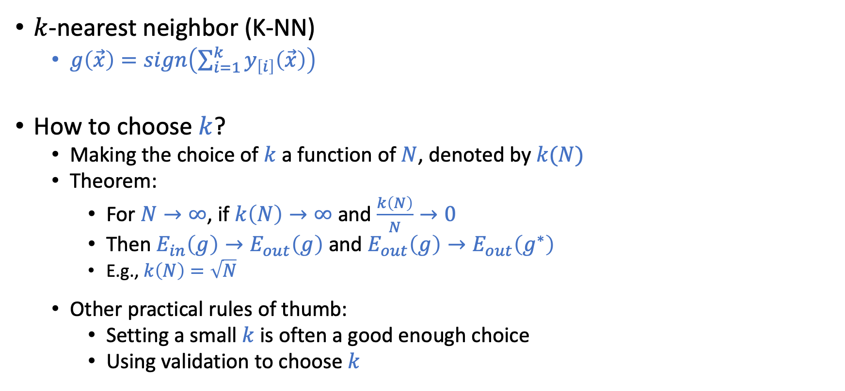
$k$-Nearest Neighbor (K-NN)
$k$-nearest neighbor (K-NN)
$g\left(\vec{x}\right)=sign\left(\sum_{i=1}^{k}{y_{\left[i\right]}\left(\vec{x}\right)}\right)$
How to choose $k$?
Making the choice of $k$ a function of $N$, denoted by$k(N)$
Theorem:
For $N→∞$, if $k\left(N\right)→∞$ and $\frac{k\left(N\right)}{N}→0$
Then $E_{in}\left(g\right)→E_{out}\left(g\right)$ and $E_{out}\left(g\right)→E_{out}\left(g^{∗}\right)$
E.g., $k\left(N\right)=\sqrt{N}$
Other practical rules of thumb:
Setting a small $k$is often a good enough choice
Using validation to choose $k$
With suitable choice of $k$, when $N→∞,$ we can recover the optimal hypothesis.

Slide 6

Summary of $k$-NN Properties
Pros
Simple algorithm
Good interpretations
Nice theoretical guarantees
Easy to adapt to regression (average of nearest neighbors) and multi-class classification (majority voting)
Cons
Curse of dimensionality
When dimensionality is high, most points won’t be close to each other
For points to be close, they need to be close in every dimension
Computational issue
Each prediction requires heavy computation

Slide 7
Dealing with Computational Issues
Reduce the number of data points
Store the data in some data structure to speed up searching
Intuition: remove points that will not impact the decision boundary.
Generally a hard problem. But there are heuristic approaches (e.g., Condensed Nearest Neighbor).
Intuition: Clustering data points
For a new data point, we might be able to “ignore” some clusters when searching for nearest neighbor.

Slide 8
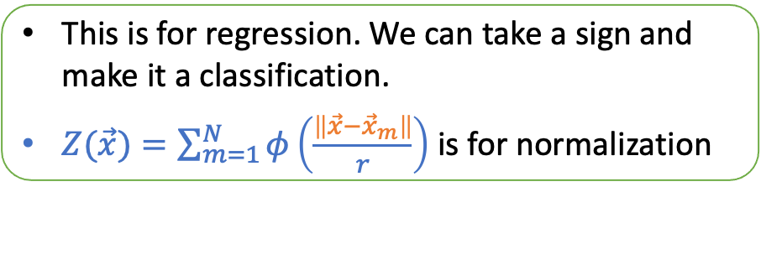
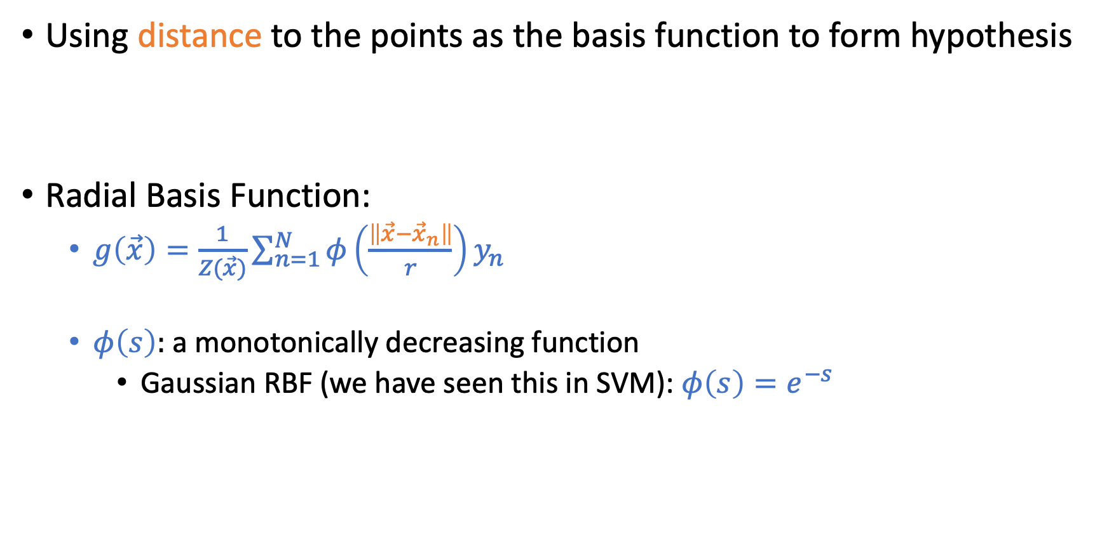
Radial Basis Function (RBF)
Using distance to the points as the basis function to form hypothesis
Radial Basis Function:
$g\left(\vec{x}\right)=\frac{1}{Z(\vec{x})}\sum_{n=1}^{N}{φ\left(\frac{\left\|\vec{x}−{\vec{x}}_{n}\right\|}{r}\right)y_{n}}$
$φ\left(s\right):$a monotonically decreasing function
Gaussian RBF (we have seen this in SVM): $φ\left(s\right)=e^{−s}$
This is for regression. We can take a sign and make it a classification.
$Z(\vec{x})=\sum_{m=1}^{N}{φ\left(\frac{\left\|\vec{x}−{\vec{x}}_{m}\right\|}{r}\right)}$ is for normalization

Slide 9
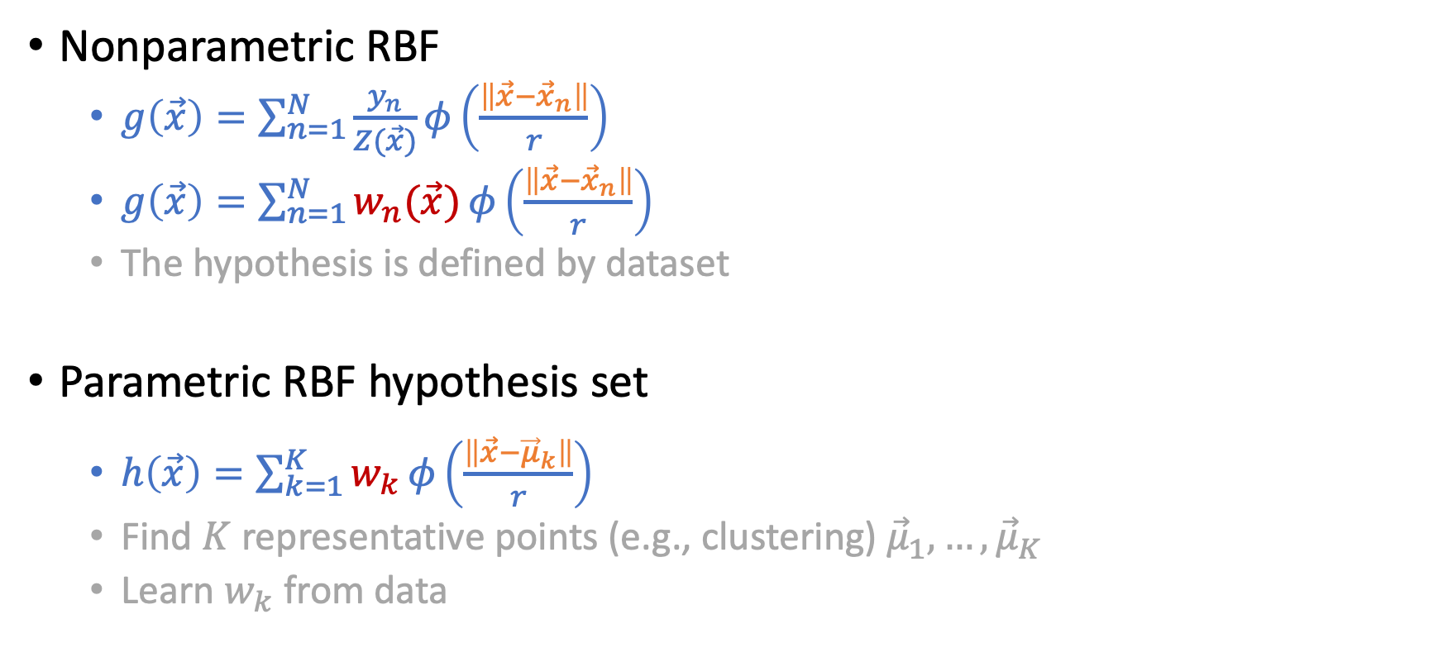
Nonparametric and Parametric RBF
Nonparametric RBF
$g\left(\vec{x}\right)=\sum_{n=1}^{N}{\frac{y_{n}}{Z(\vec{x})}}φ\left(\frac{\left\|\vec{x}−{\vec{x}}_{n}\right\|}{r}\right)$
$g\left(\vec{x}\right)=\sum_{n=1}^{N}{w_{n}(\vec{x})}φ\left(\frac{\left\|\vec{x}−{\vec{x}}_{n}\right\|}{r}\right)$
The hypothesis is defined by dataset
Parametric RBF hypothesis set
$h\left(\vec{x}\right)=\sum_{k=1}^{K}{w_{k}}φ\left(\frac{\left\|\vec{x}−{\vec{μ}}_{k}\right\|}{r}\right)$
Find $K$ representative points (e.g., clustering) ${\vec{μ}}_{1},…,{\vec{μ}}_{K}$
Learn $w_{k}$ from data

Slide 10
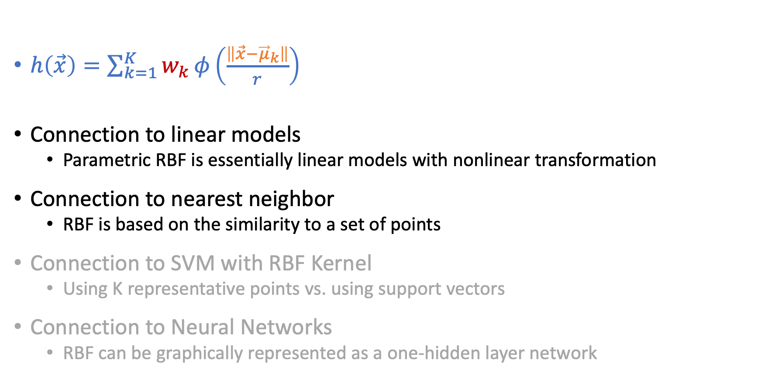
Connection to Other Hypothesis Sets
$h\left(\vec{x}\right)=\sum_{k=1}^{K}{w_{k}}φ\left(\frac{\left\|\vec{x}−{\vec{μ}}_{k}\right\|}{r}\right)$
Connection to linear models
Parametric RBF is essentially linear models with nonlinear transformation
Connection to nearest neighbor
RBF is based on the similarity to a set of points
Connection to SVM with RBF Kernel
Using K representative points vs. using support vectors
Connection to Neural Networks
RBF can be graphically represented as a one-hidden layer network

Slide 11
Support Vector Machines (SVM)

Slide 12

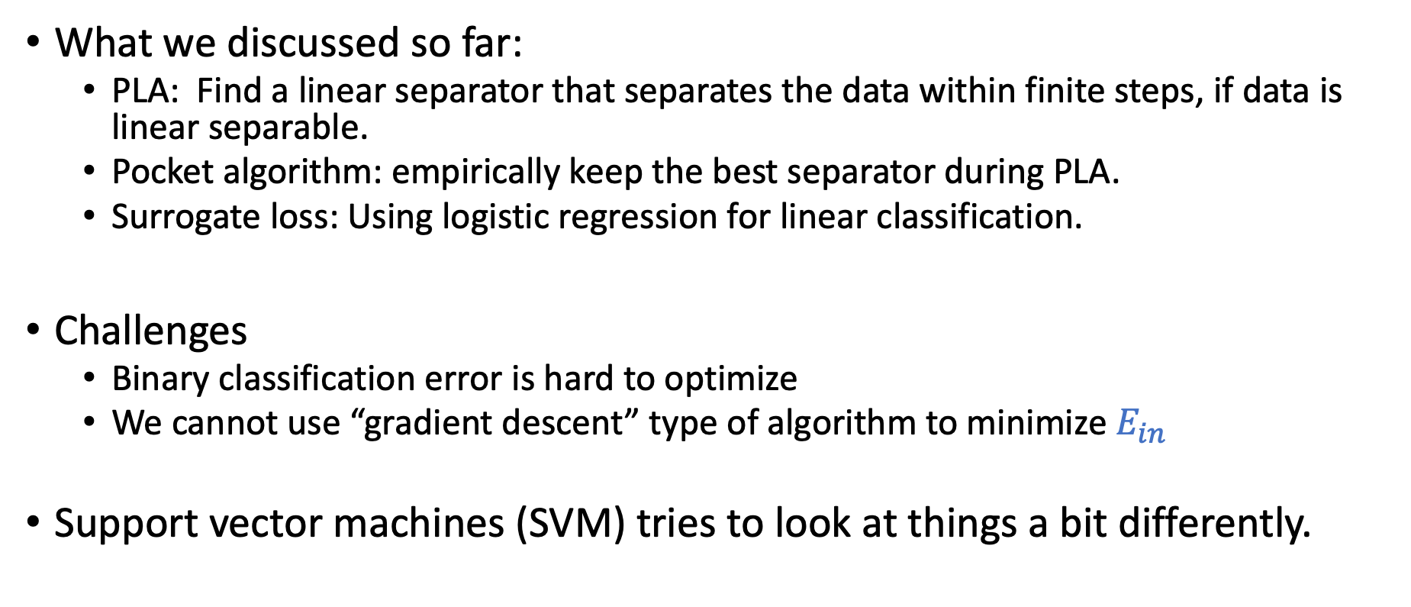
What Do We Know about Linear Classification?
What we discussed so far:
PLA: Find a linear separator that separates the data within finite steps, if data is linear separable.
Pocket algorithm: empirically keep the best separator during PLA.
Surrogate loss: Using logistic regression for linear classification.
Challenges
Binary classification error is hard to optimize
We cannot use “gradient descent” type of algorithm to minimize $E_{in}$
Support vector machines (SVM) tries to look at things a bit differently.

Slide 13
Linear Classification
Which separator would you choose?

Slide 14
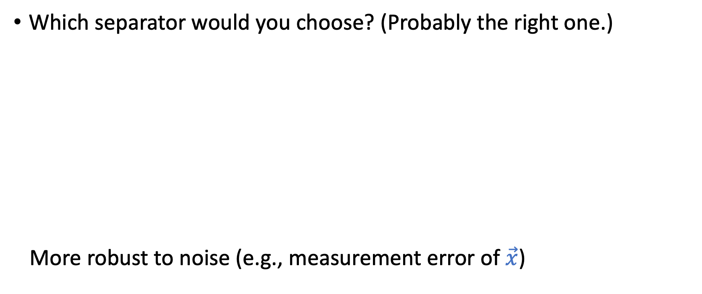
Linear Classification
Which separator would you choose? (Probably the right one.)
More robust to noise (e.g., measurement error of $\vec{x}$)

Slide 15
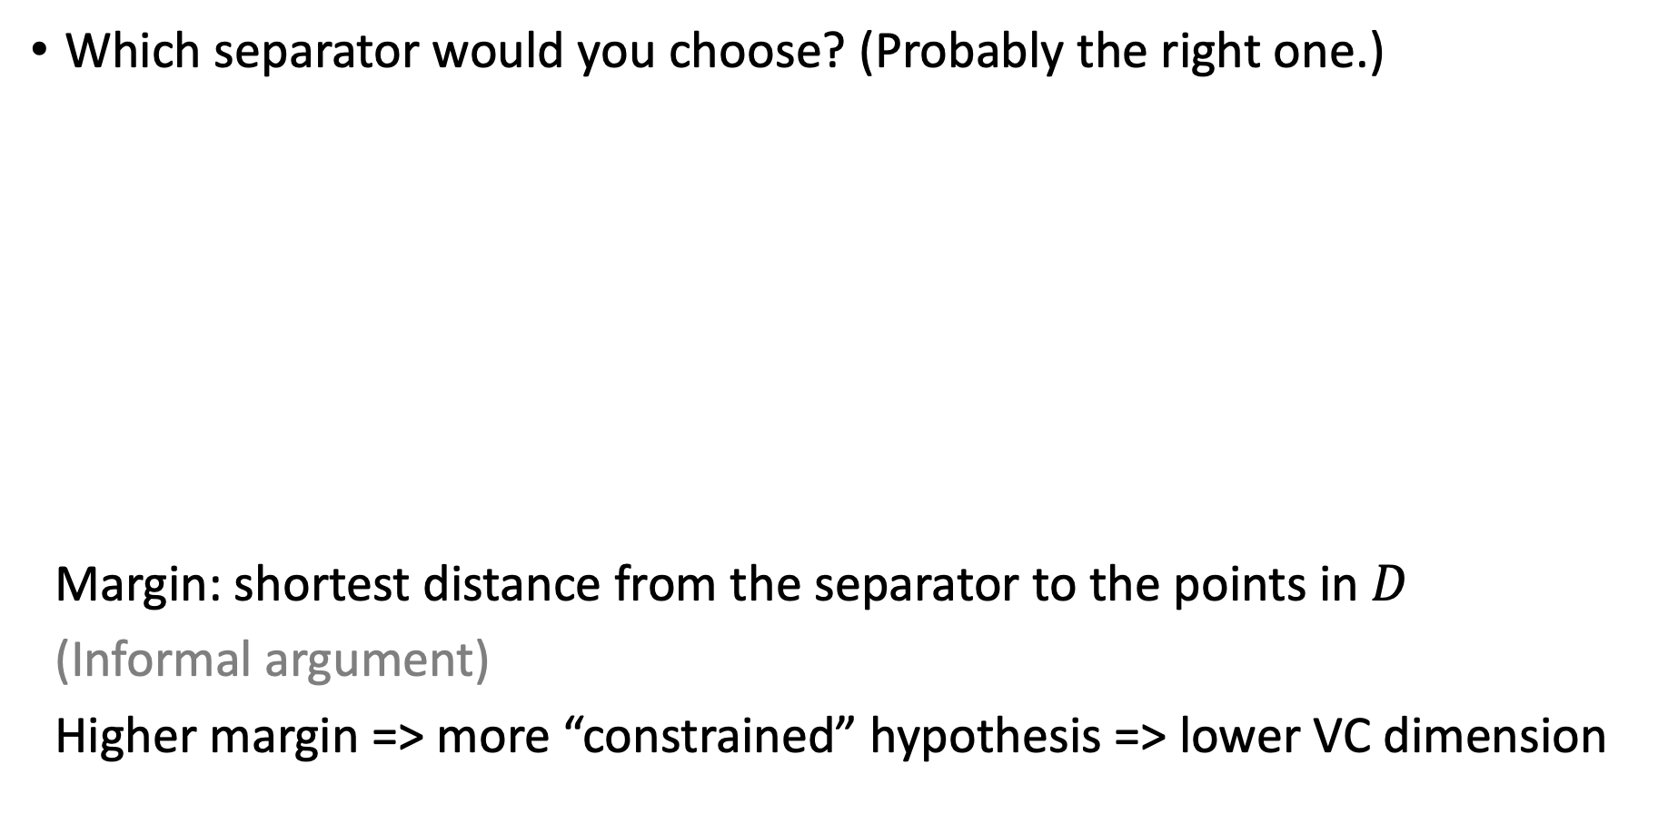
Linear Classification
Which separator would you choose? (Probably the right one.)
Margin: shortest distance from the separator to the points in $D$
(Informal argument)
Higher margin => more “constrained” hypothesis => lower VC dimension
Margin

Slide 16
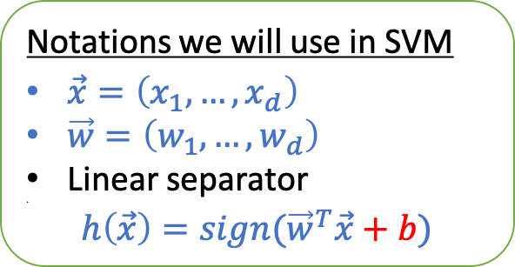
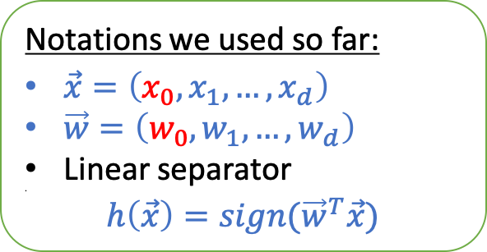

Support Vector Machine
Goal:
Find the max-margin linear separator that separates the data
Recall the goal of PLA: Find the linear separator that separates the data
Notations:
Notations we used so far:
$\vec{x}=\left(x_{0},x_{1},…,x_{d}\right)$
$\vec{w}=\left(w_{0},w_{1},…,w_{d}\right)$
Linear separator
$h\left(\vec{x}\right)=sign({\vec{w}}^{T}\vec{x})$
Notations we will use in SVM
$\vec{x}=\left(x_{1},…,x_{d}\right)$
$\vec{w}=\left(w_{1},…,w_{d}\right)$
Linear separator
$h\left(\vec{x}\right)=sign({\vec{w}}^{T}\vec{x}+b)$
Separating the bias/intercept $b$ is important for us to characterize the margin.
We will use $(\vec{w},b)$ to characterize the hypothesis

Slide 17
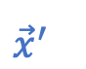
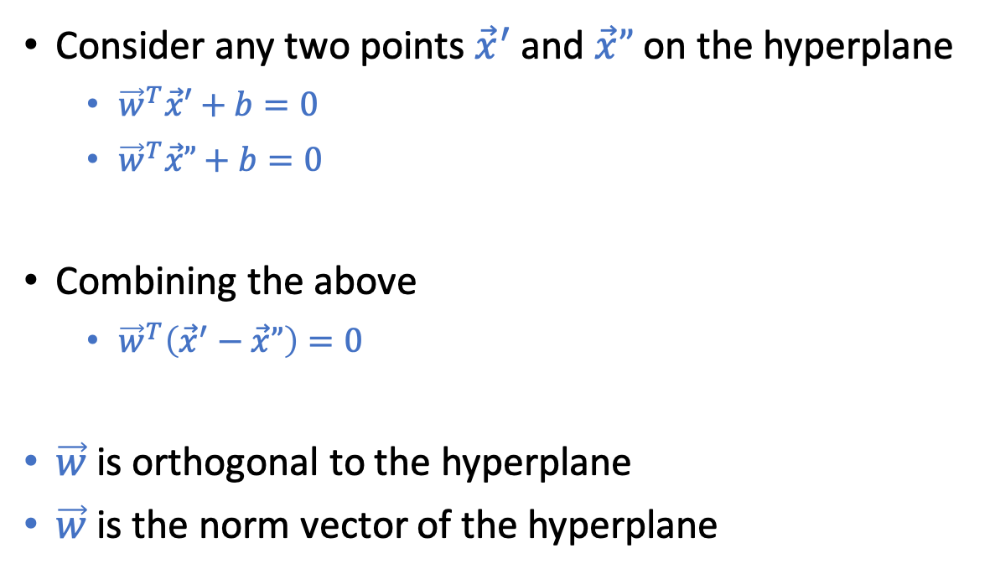
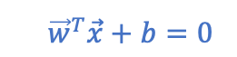

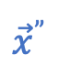
Relevant Review of Linear Algebra
Claim: $\vec{w}$ is the norm vector of the hyperplane ${\vec{w}}^{T}\vec{x}+b=0$
Consider any two points ${\vec{x}}^{′}$ and $\vec{x}”$ on the hyperplane
${\vec{w}}^{T}\vec{x}′+b=0$
${\vec{w}}^{T}\vec{x}”+b=0$
Combining the above
${\vec{w}}^{T}\left({\vec{x}}^{′}−\vec{x}”\right)=0$
$\vec{w}$ is orthogonal to the hyperplane
$\vec{w}$ is the norm vector of the hyperplane
$$\vec{w}$$
$${\vec{x}}^{′}$$
$${\vec{x}}^{”}$$
$${\vec{w}}^{T}\vec{x}+b=0$$

Slide 18
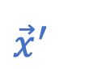
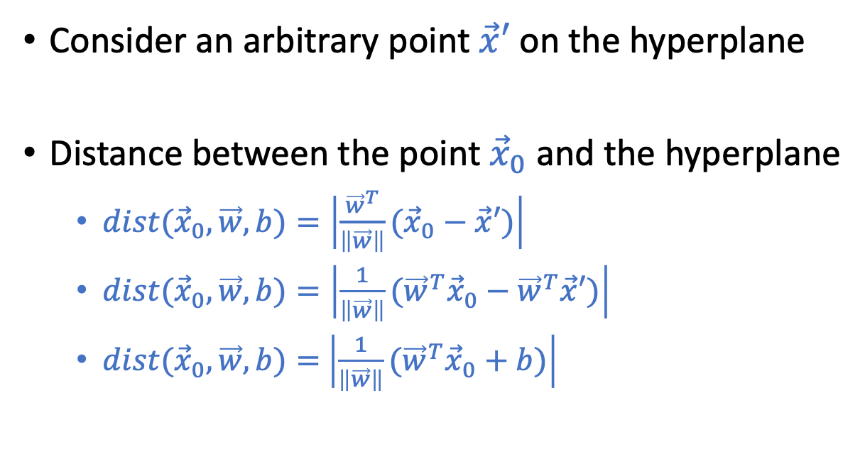
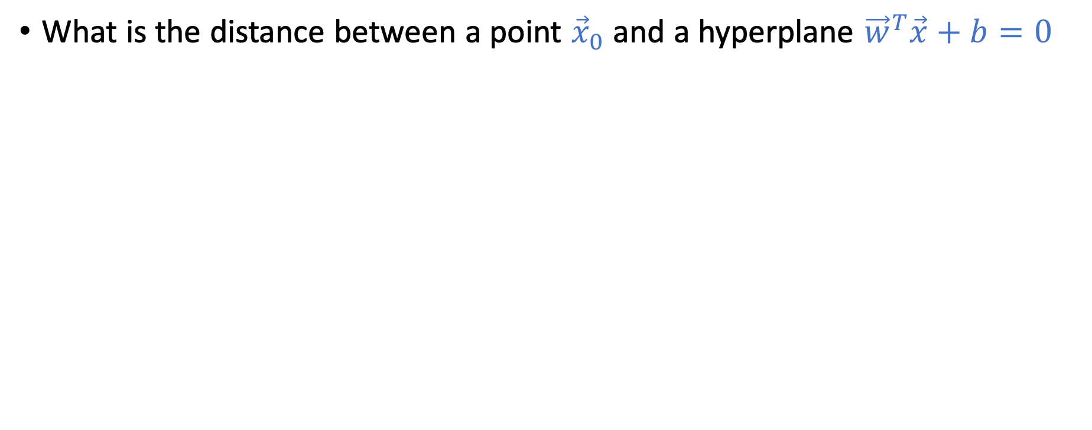
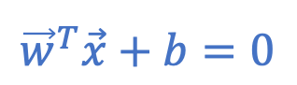

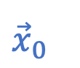
Relevant Review of Linear Algebra
What is the distance between a point ${\vec{x}}_{0}$ and a hyperplane ${\vec{w}}^{T}\vec{x}+b=0$
Consider an arbitrary point $\vec{x}′$ on the hyperplane
Distance between the point ${\vec{x}}_{0}$ and the hyperplane
$dist({\vec{x}}_{0},\vec{w},b)=\left|\frac{{\vec{w}}^{T}}{\left\|\vec{w}\right\|}({\vec{x}}_{0}−\vec{x}′)\right|$
$dist({\vec{x}}_{0},\vec{w},b)=\left|\frac{1}{\left\|\vec{w}\right\|}({\vec{w}}^{T}{\vec{x}}_{0}−{\vec{w}}^{T}\vec{x}′)\right|$
$dist({\vec{x}}_{0},\vec{w},b)=$ $\left|\frac{1}{\left\|\vec{w}\right\|}({\vec{w}}^{T}{\vec{x}}_{0}+b)\right|$
$${\vec{x}}_{0}$$
$$\vec{w}$$
$${\vec{x}}^{′}$$
$${\vec{w}}^{T}\vec{x}+b=0$$

Slide 19
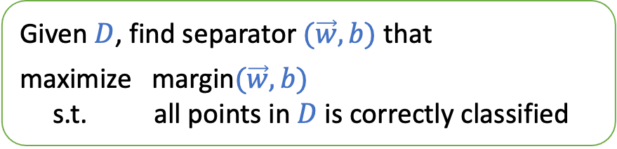
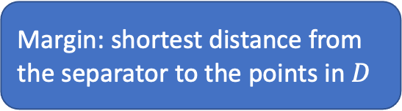
Outline of Our Discussion for SVM
Assume data is linearly separable
Formulate the hard-margin SVM
When data is not linearly separable
Tolerate some noise
Soft-margin SVM
Given $D$, find separator $(\vec{w},b)$ that
maximize margin$(\vec{w},b)$
s.t. all points in $D$ is correctly classified
Margin: shortest distance from the separator to the points in $D$
Nonlinear transform
Dual formulation and kernel tricks

Slide 20
Today’s Lecture
The notes are not intended to be comprehensive. They should be accompanied by lectures and/or textbook.
Let me know if you spot errors.
Notes:
This is the lecture I wish I have 6 chalkboards to utilize

Slide 21
Hard-Margin SVM

Slide 22
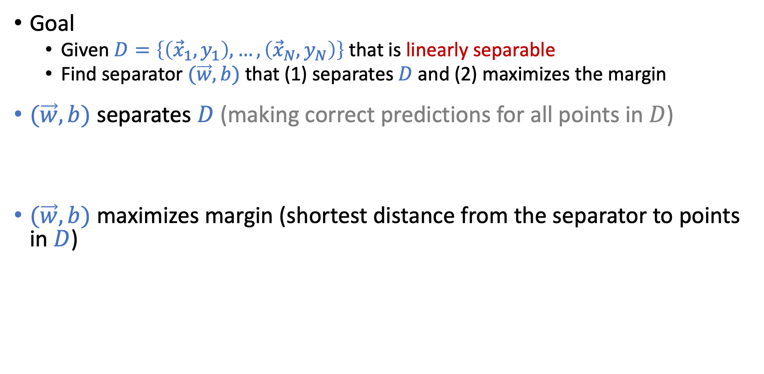
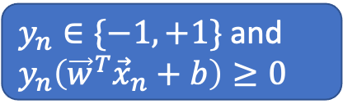
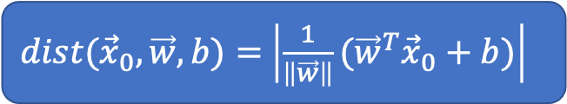
Hard-Margin SVM
Goal
Given $D=\left\{\left({\vec{x}}_{1},y_{1}\right),…,\left({\vec{x}}_{N},y_{N}\right)\right\}$ that is linearly separable
Find separator $(\vec{w},b)$ that (1) separates $D$and (2) maximizes the margin
$(\vec{w},b)$ separates $D$ (making correct predictions for all points in $D$)
$y_{n}=$ $sign({\vec{w}}^{T}{\vec{x}}_{n}+b)$ for all $n$
$y_{n}\left({\vec{w}}^{T}{\vec{x}}_{n}+b\right)≥0$ for all $n$
$(\vec{w},b)$ maximizes margin (shortest distance from the separator to points in $D$)
$\text{margin}\left(\vec{w},b\right)=min_{n}{dist({\vec{x}}_{n},\vec{w},b)}$
$\text{margin}\left(\vec{w},b\right)=min_{n}\left|\frac{1}{\left\|\vec{w}\right\|}({\vec{w}}^{T}{\vec{x}}_{n}+b)\right|$
$\text{margin}\left(\vec{w},b\right)=min_{n}{\frac{1}{\left\|\vec{w}\right\|}}y_{n}({\vec{w}}^{T}{\vec{x}}_{n}+b)$
$dist({\vec{x}}_{0},\vec{w},b)=$ $\left|\frac{1}{\left\|\vec{w}\right\|}({\vec{w}}^{T}{\vec{x}}_{0}+b)\right|$
$y_{n}∈\{−1,+1\}$ and $y_{n}\left({\vec{w}}^{T}{\vec{x}}_{n}+b\right)≥0$

Slide 23
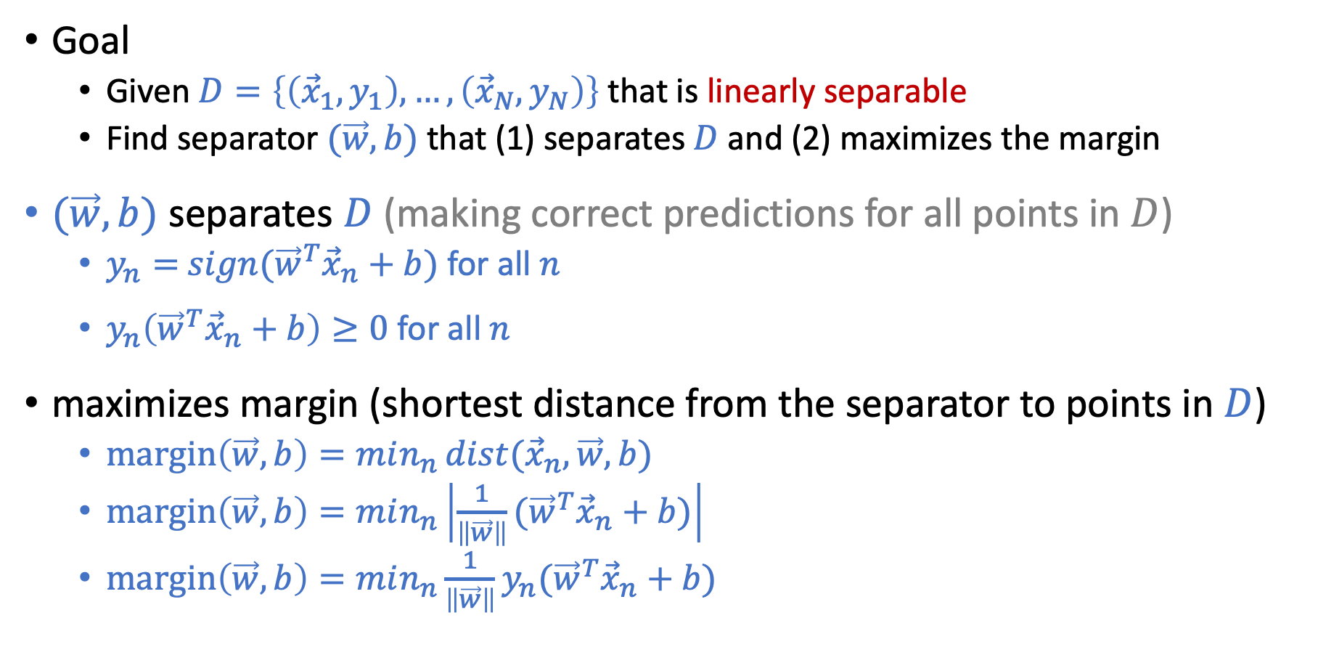
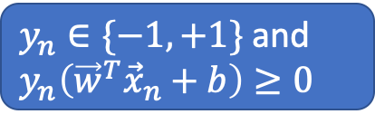
Hard-Margin SVM
Goal
Given $D=\left\{\left({\vec{x}}_{1},y_{1}\right),…,\left({\vec{x}}_{N},y_{N}\right)\right\}$ that is linearly separable
Find separator $(\vec{w},b)$ that (1) separates $D$and (2) maximizes the margin
$(\vec{w},b)$ separates $D$ (making correct predictions for all points in $D$)
$y_{n}=$ $sign({\vec{w}}^{T}{\vec{x}}_{n}+b)$ for all $n$
$y_{n}\left({\vec{w}}^{T}{\vec{x}}_{n}+b\right)≥0$ for all $n$
maximizes margin (shortest distance from the separator to points in $D$)
$\text{margin}\left(\vec{w},b\right)=min_{n}{dist({\vec{x}}_{n},\vec{w},b)}$
$\text{margin}\left(\vec{w},b\right)=min_{n}\left|\frac{1}{\left\|\vec{w}\right\|}({\vec{w}}^{T}{\vec{x}}_{n}+b)\right|$
$\text{margin}\left(\vec{w},b\right)=min_{n}{\frac{1}{\left\|\vec{w}\right\|}}y_{n}({\vec{w}}^{T}{\vec{x}}_{n}+b)$
$dist({\vec{x}}_{0},\vec{w},b)=$ $\left|\frac{1}{\left\|\vec{w}\right\|}({\vec{w}}^{T}{\vec{x}}_{0}+b)\right|$
$y_{n}∈\{−1,+1\}$ and $y_{n}\left({\vec{w}}^{T}{\vec{x}}_{n}+b\right)≥0$

Slide 24
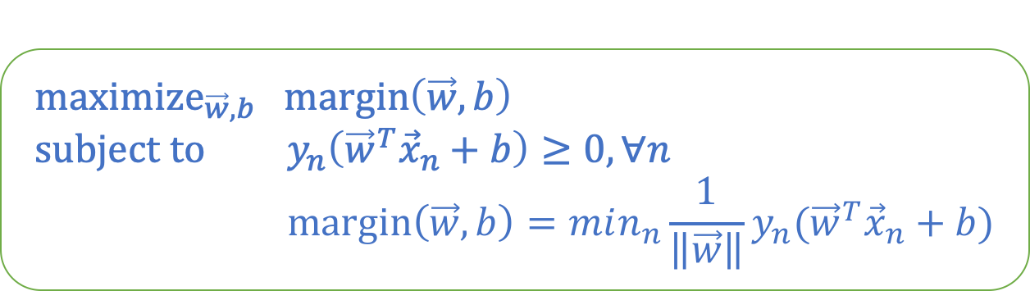
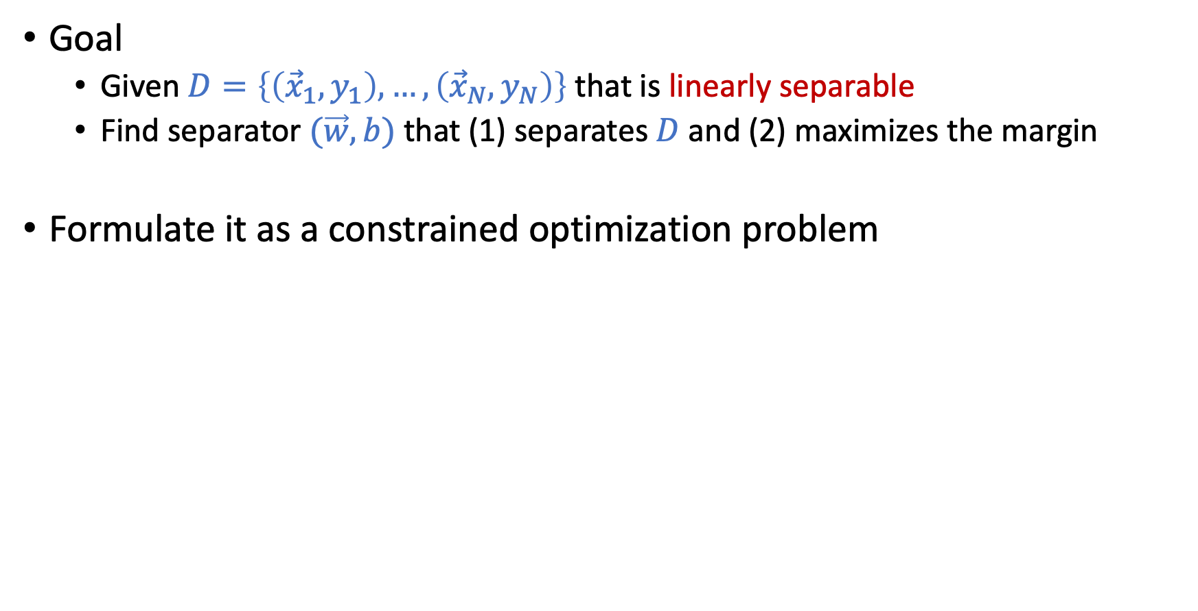
Hard-Margin SVM
Goal
Given $D=\left\{\left({\vec{x}}_{1},y_{1}\right),…,\left({\vec{x}}_{N},y_{N}\right)\right\}$ that is linearly separable
Find separator $(\vec{w},b)$ that (1) separates $D$and (2) maximizes the margin
Formulate it as a constrained optimization problem
$${\text{maximize}}_{\vec{w},b} \text{margin}\left(\vec{w},b\right) \\ \text{subject} \text{to} y_{n}\left({\vec{w}}^{T}{\vec{x}}_{n}+b\right)≥0, ∀n \\ \text{margin}\left(\vec{w},b\right)=min_{n}{\frac{1}{\left\|\vec{w}\right\|}}y_{n}({\vec{w}}^{T}{\vec{x}}_{n}+b)$$

Slide 25

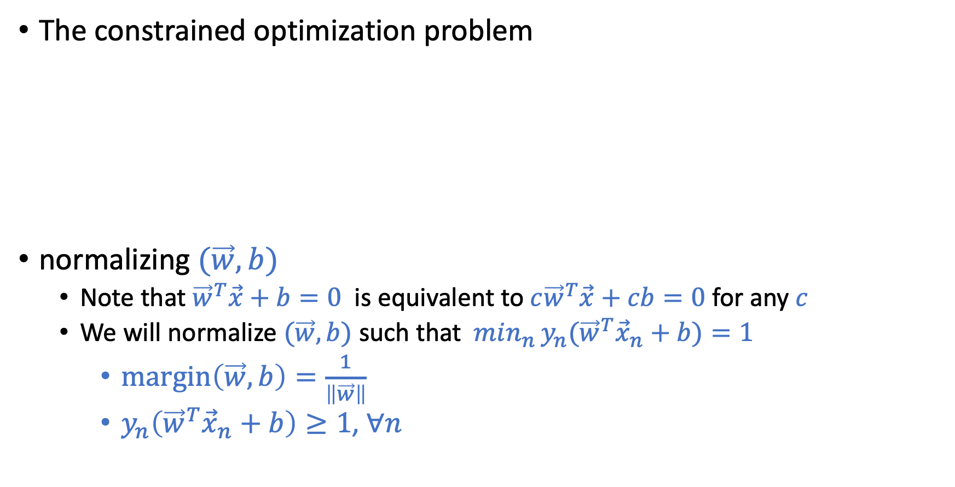
Hard-Margin SVM
The constrained optimization problem
normalizing $(\vec{w},b)$
Note that ${\vec{w}}^{T}\vec{x}+b=0$ is equivalent to $c{\vec{w}}^{T}\vec{x}+cb=0$ for any $c$
We will normalize $(\vec{w},b)$ such that $min_{n}{y_{n}({\vec{w}}^{T}{\vec{x}}_{n}+b})=1$
$\text{margin}\left(\vec{w},b\right)=\frac{1}{\left\|\vec{w}\right\|}$
$y_{n}\left({\vec{w}}^{T}{\vec{x}}_{n}+b\right)≥1$, $∀n$
$${\text{maximize}}_{\vec{w},b} \text{margin}\left(\vec{w},b\right) \\ \text{subject} \text{to} y_{n}\left({\vec{w}}^{T}{\vec{x}}_{n}+b\right)≥0, ∀n \\ \text{margin}\left(\vec{w},b\right)=min_{n}{\frac{1}{\left\|\vec{w}\right\|}}y_{n}({\vec{w}}^{T}{\vec{x}}_{n}+b)$$

Slide 26
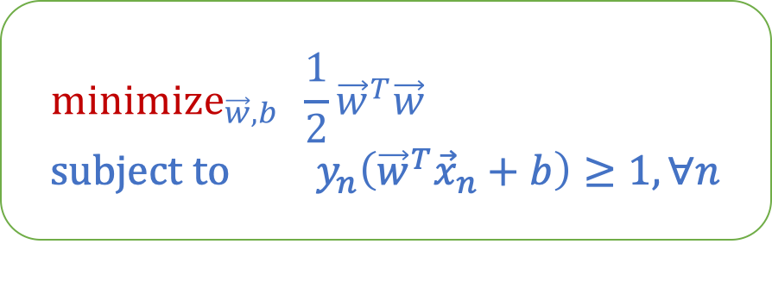
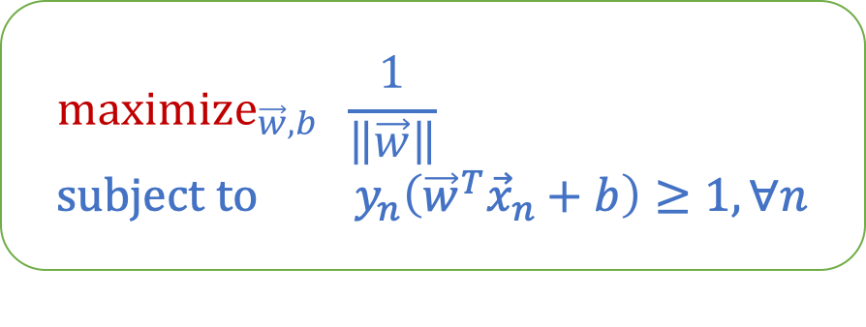
Hard-Margin SVM
The constrained optimization problem
Some final adjustments
$${\text{maximize}}_{\vec{w},b} \frac{1}{\left\|\vec{w}\right\|} \\ \text{subject} \text{to} y_{n}\left({\vec{w}}^{T}{\vec{x}}_{n}+b\right)≥1, ∀n$$
$${\text{minimize}}_{\vec{w},b} \frac{1}{2}{\vec{w}}^{T}\vec{w} \\ \text{subject} \text{to} y_{n}\left({\vec{w}}^{T}{\vec{x}}_{n}+b\right)≥1, ∀n$$

Slide 27
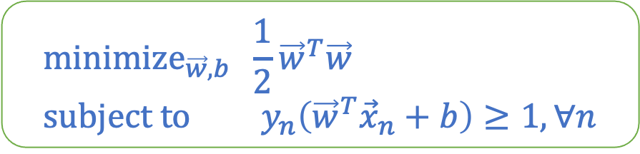
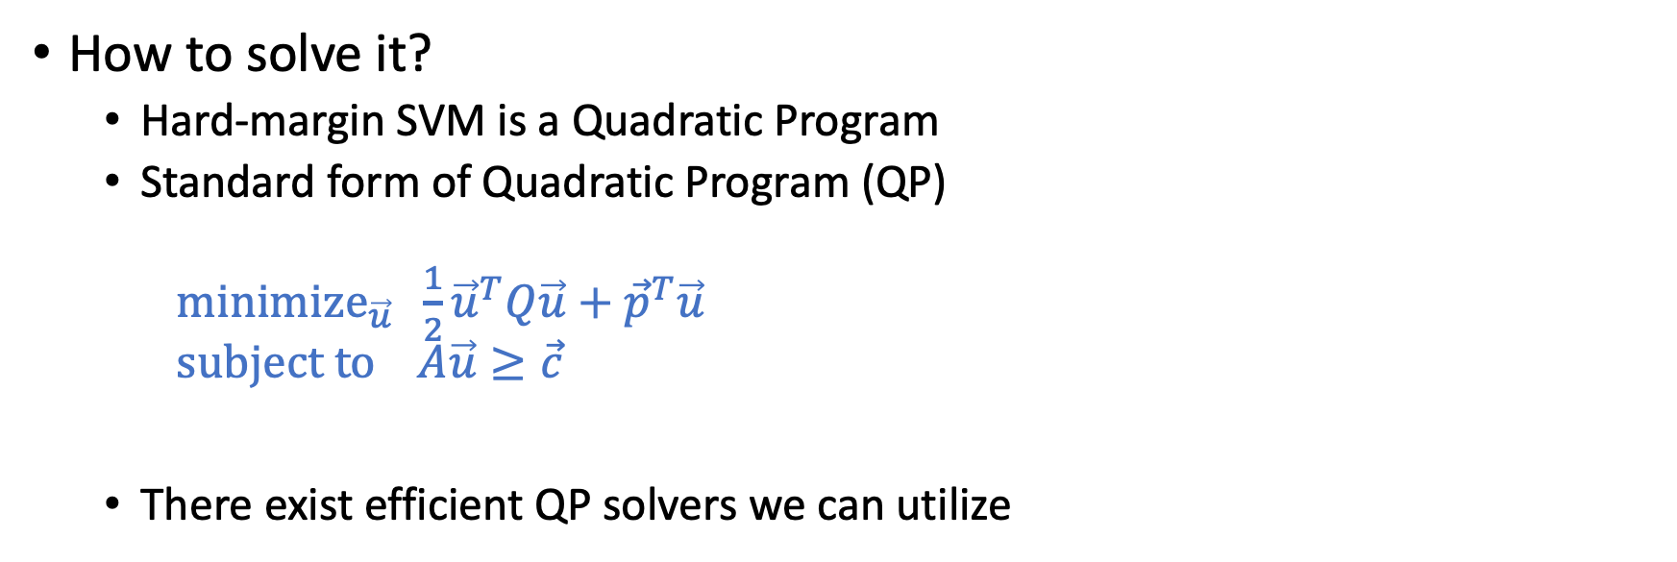
Final Form of Hard-Margin SVM
$${\text{minimize}}_{\vec{w},b} \frac{1}{2}{\vec{w}}^{T}\vec{w} \\ \text{subject} \text{to} y_{n}\left({\vec{w}}^{T}{\vec{x}}_{n}+b\right)≥1, ∀n$$
Short Break and Questions:
How to construct QP for hard-margin SVM
How to solve it?
Hard-margin SVM is a Quadratic Program
Standard form of Quadratic Program (QP)
${\text{minimize}}_{\vec{u}} \frac{1}{2}{\vec{u}}^{T}Q\vec{u}+{\vec{p}}^{T}\vec{u}$ $\text{subject} \text{to} A\vec{u}≥\vec{c}$
There exist efficient QP solvers we can utilize

Slide 28
Some Discussion on SVM

Slide 29
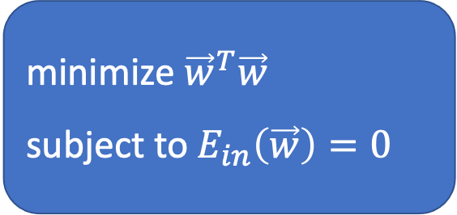
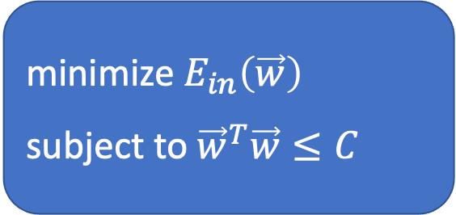
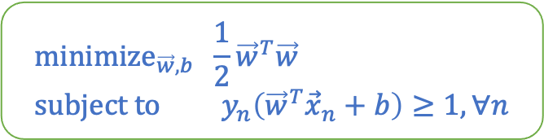
Connection to Regularization
$${\text{minimize}}_{\vec{w},b} \frac{1}{2}{\vec{w}}^{T}\vec{w} \\ \text{subject} \text{to} y_{n}\left({\vec{w}}^{T}{\vec{x}}_{n}+b\right)≥1, ∀n$$
Another way to look at SVM
Weight decay regularization
minimize ${\vec{w}}^{T}\vec{w}$
subject to $E_{in}\left(\vec{w}\right)=0$
minimize $E_{in}\left(\vec{w}\right)$
subject to ${\vec{w}}^{T}\vec{w}≤C$
Maximizing margin is similar to applying regularization!
You’ll see that these two interpretations are somewhat “equivalent” when we introduce Lagragian later this lecture or next lecture.

Slide 30
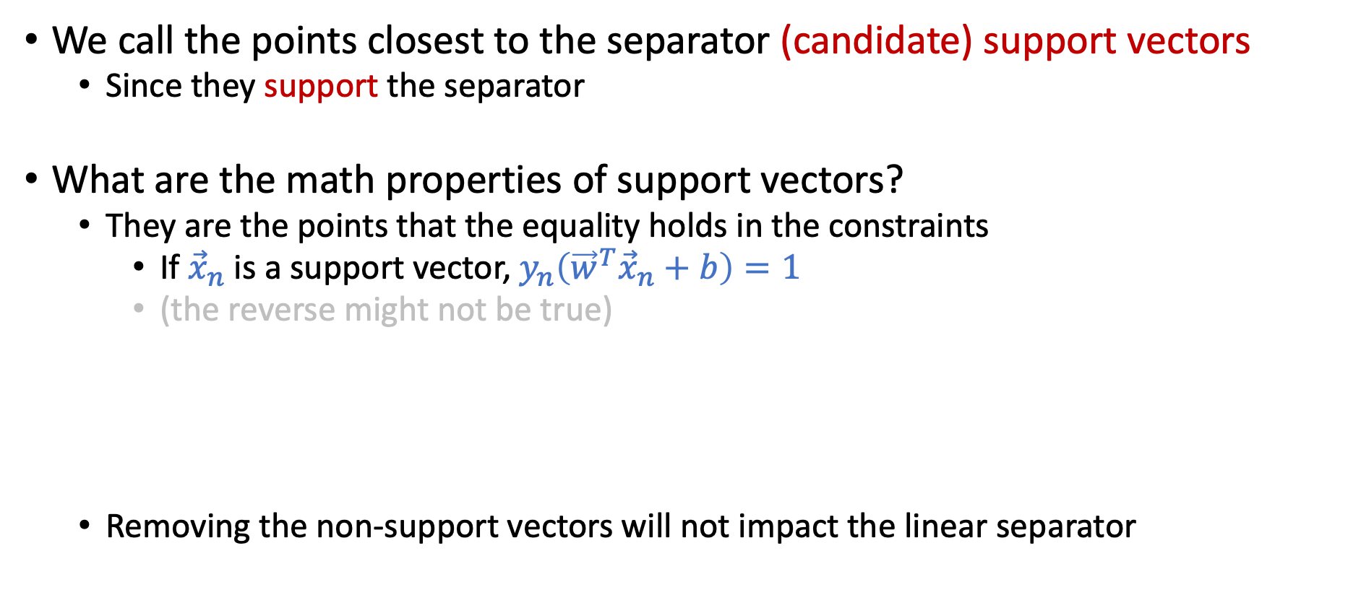
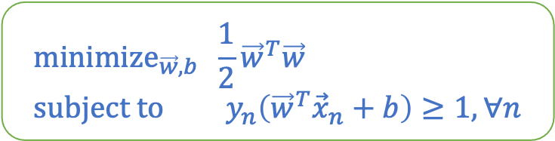
Support Vectors
We’ll more formally define support vectors next lecture.
We call the points closest to the separator (candidate) support vectors
Since they support the separator
What are the math properties of support vectors?
They are the points that the equality holds in the constraints
If ${\vec{x}}_{n}$ is a support vector, $y_{n}\left({\vec{w}}^{T}{\vec{x}}_{n}+b\right)=1$
(the reverse might not be true)
Removing the non-support vectors will not impact the linear separator
$${\text{minimize}}_{\vec{w},b} \frac{1}{2}{\vec{w}}^{T}\vec{w} \\ \text{subject} \text{to} y_{n}\left({\vec{w}}^{T}{\vec{x}}_{n}+b\right)≥1, ∀n$$

Slide 31
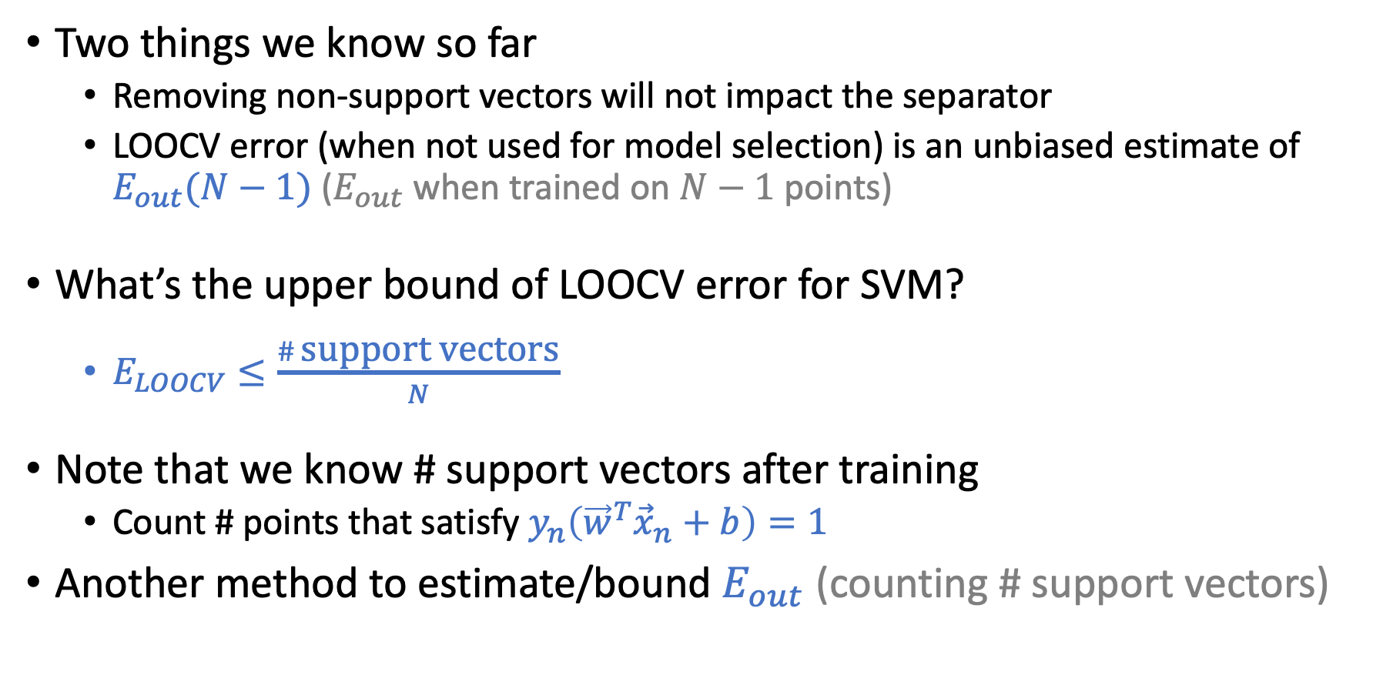
Leave-One-Out Cross Validation (LOOCV)
Two things we know so far
Removing non-support vectors will not impact the separator
LOOCV error (when not used for model selection) is an unbiased estimate of $E_{out}(N−1)$ ($E_{out}$ when trained on $N−1$ points)
What’s the upper bound of LOOCV error for SVM?
$E_{LOOCV}≤\frac{\# \text{support} \text{vectors}}{N}$
Note that we know # support vectors after training
Count # points that satisfy $y_{n}\left({\vec{w}}^{T}{\vec{x}}_{n}+b\right)=1$
Another method to estimate/bound $E_{out}$ (counting # support vectors)

Slide 32
What if Data is Not Linearly Separable

Slide 33
Non-Separable Data
Two scenarios
Tolerate some noise
Soft-Margin SVM
Nonlinear transform
Dual formulation and kernel tricks

Slide 34
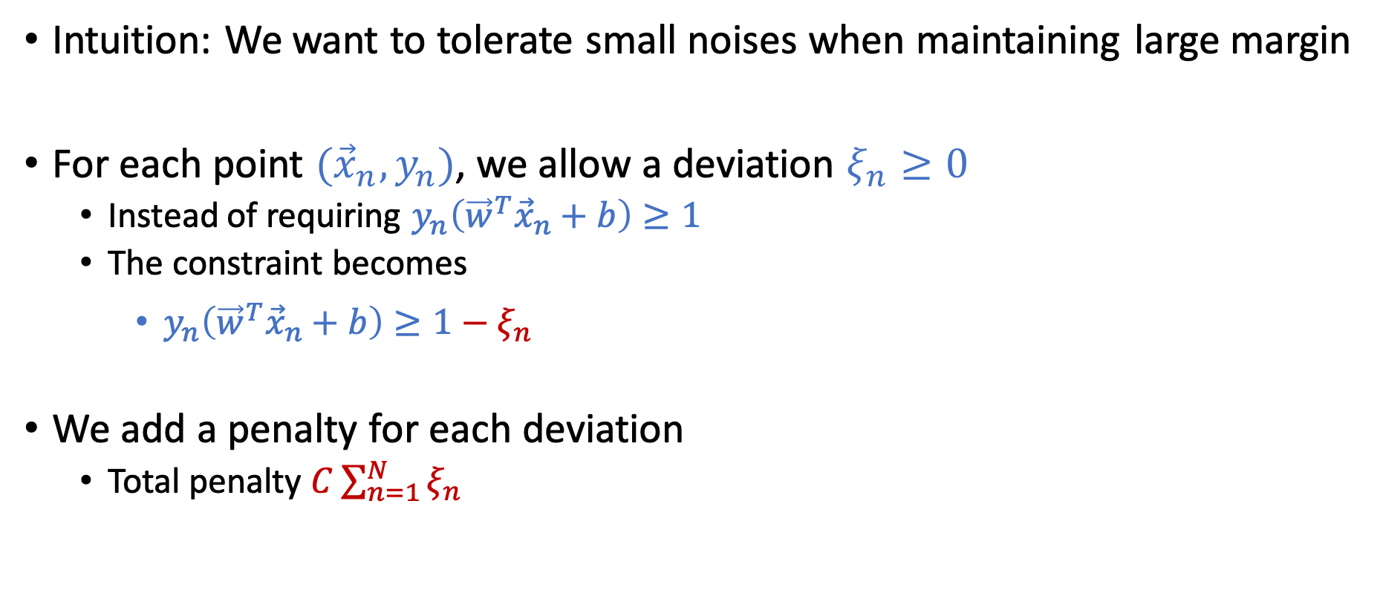
Soft-Margin SVM
Intuition: We want to tolerate small noises when maintaining large margin
For each point $({\vec{x}}_{n},y_{n})$, we allow a deviation $ξ_{n}≥0$
Instead of requiring $y_{n}\left({\vec{w}}^{T}{\vec{x}}_{n}+b\right)≥1$
The constraint becomes
$y_{n}\left({\vec{w}}^{T}{\vec{x}}_{n}+b\right)≥1−ξ_{n}$
We add a penalty for each deviation
Total penalty $C\sum_{n=1}^{N}{ξ_{n}}$

Slide 35
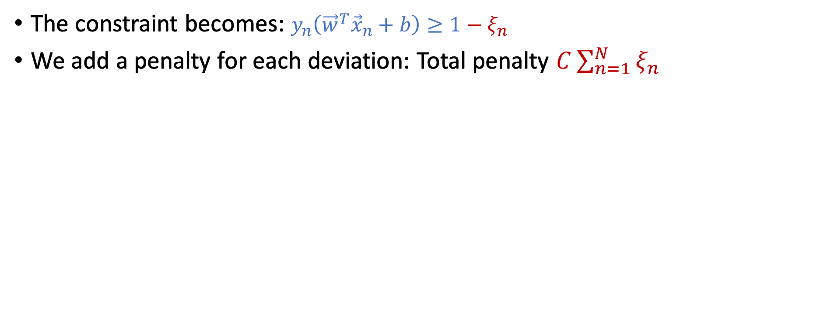
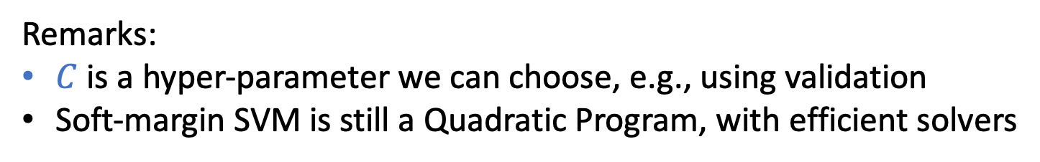
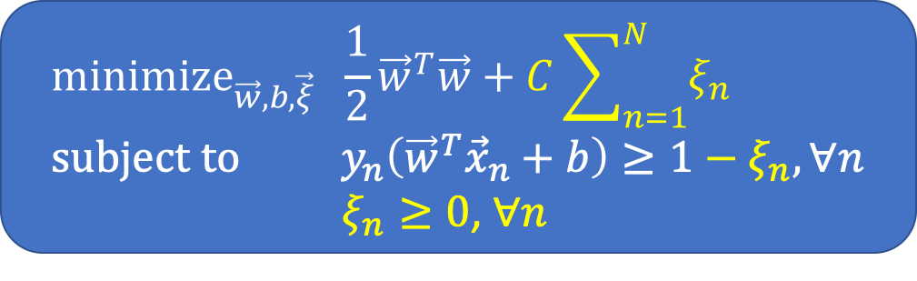
Soft-Margin SVM
The constraint becomes: $y_{n}\left({\vec{w}}^{T}{\vec{x}}_{n}+b\right)≥1−ξ_{n}$
We add a penalty for each deviation: Total penalty $C\sum_{n=1}^{N}{ξ_{n}}$
$${\text{minimize}}_{\vec{w},b,\vec{ξ}} \frac{1}{2}{\vec{w}}^{T}\vec{w}+C\sum_{n=1}^{N}{ξ_{n}} \\ \text{subject} \text{to} y_{n}\left({\vec{w}}^{T}{\vec{x}}_{n}+b\right)≥1−ξ_{n}, ∀n$$
$ξ_{n}≥0$, $∀n$
Remarks:
$C$ is a hyper-parameter we can choose, e.g., using validation
Soft-margin SVM is still a Quadratic Program, with efficient solvers

Slide 36
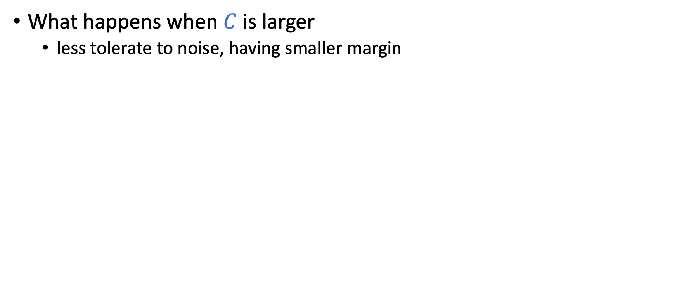

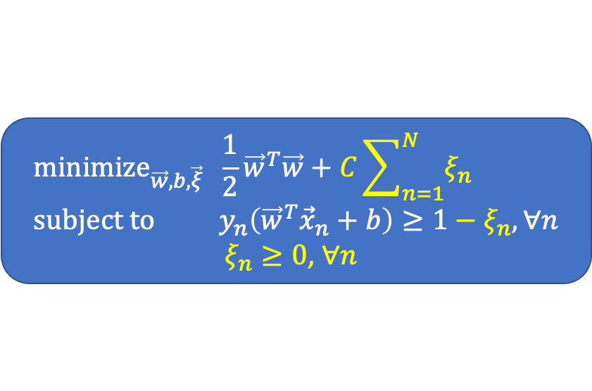
Impacts of $C$ in Soft-Margin SVM
What happens when $C$ is larger
less tolerate to noise, having smaller margin
$${\text{minimize}}_{\vec{w},b,\vec{ξ}} \frac{1}{2}{\vec{w}}^{T}\vec{w}+C\sum_{n=1}^{N}{ξ_{n}} \\ \text{subject} \text{to} y_{n}\left({\vec{w}}^{T}{\vec{x}}_{n}+b\right)≥1−ξ_{n}, ∀n$$
$ξ_{n}≥0$, $∀n$

Slide 37
What if Tolerating Small Noises Is Not Enough
Nonlinear transform
We can apply standard nonlinear transformation procedure we talked about before
In SVM, we can combine the ideas of dual formulation and kernel tricks for the transformation
This is one of the key ingredients that makes SVM powerful

Slide 38
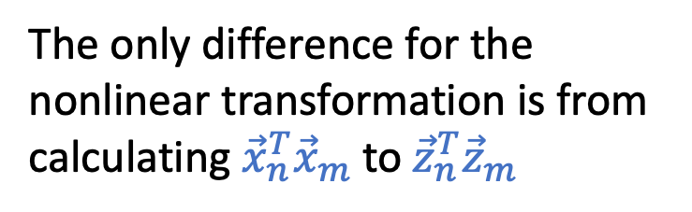





Nonlinear Transform: $\vec{z}=Φ(\vec{x})$
Consider hard-margin SVM in the $\vec{z}$ space
There exists a corresponding dual formulation (more next lecture)
Why dual
The optimal primal is the same as the optimal dual
We can infer the optimal primal solutions from the optimal dual solutions
$${\text{minimize}}_{\vec{w},b} \frac{1}{2}{\vec{w}}^{T}\vec{w} \\ \text{subject} \text{to} y_{n}\left({\vec{w}}^{T}{\vec{z}}_{n}+b\right)≥1, ∀n$$
Involves changing $\vec{w}$ and $\vec{z}$.
The computation grows as the dimension of the $\vec{z}$ space grows
${\text{maximize}}_{\vec{α}}\sum_{n=1}^{N}{α_{n}}−\frac{1}{2}\sum_{n=1}^{N}{\sum_{m=1}^{N}{α_{n}α_{m}y_{n}y_{m}{\vec{z}}_{n}^{T}{\vec{z}}_{m}}}$ $\text{subject} \text{to} \sum_{n=1}^{N}{α_{n}y_{n}=0}$ $α_{n}≥0,∀n$
The only difference for the nonlinear transformation is from calculating ${\vec{x}}_{n}^{T}{\vec{x}}_{m}$ to ${\vec{z}}_{n}^{T}{\vec{z}}_{m}$

Slide 39



Next Lecture
Primal-dual formulations using Lagrangian
Kernel tricks
Intuition: If we can find an efficient way to calculate ${\vec{z}}_{n}^{T}{\vec{z}}_{m}$, we can efficiently derive the optimal dual to infer the optimal primal.
Doing nonlinear transform without sacrificing much about computation.
$${\text{minimize}}_{\vec{w},b} \frac{1}{2}{\vec{w}}^{T}\vec{w} \\ \text{subject} \text{to} y_{n}\left({\vec{w}}^{T}{\vec{z}}_{n}+b\right)≥1, ∀n$$
${\text{maximize}}_{\vec{α}}\sum_{n=1}^{N}{α_{n}}−\frac{1}{2}\sum_{n=1}^{N}{\sum_{m=1}^{N}{α_{n}α_{m}y_{n}y_{m}{\vec{z}}_{n}^{T}{\vec{z}}_{m}}}$ $\text{subject} \text{to} \sum_{n=1}^{N}{α_{n}y_{n}=0}$ $α_{n}≥0,∀n$

Slide 40
Lagrangian Duality and Convex Optimization
[The next few slides are safe to skip for the exam, but they contain useful concepts for optimization/ML]

Slide 41



Convex Optimization
Standard form of convex optimization
Convex program
$f$ and $g_{i}$ are convex and $h_{j}$ are affine
Mostly implies the existence of efficient solvers
Special cases
Linear program: $f, g_{i}, h_{j}$ are all affine
Quadratic program: $f$ is quadratic; $g_{i} and$ $h_{j}$ are affine
Objective
$${\text{minimize}}_{\vec{w}} f(\vec{w}) \\ \text{subject} \text{to} g_{i}\left(\vec{w}\right)≤0, i=1,…,k \\ h_{j}\left(\vec{w}\right)=0, j=1,…,ℓ$$
Inequality constraints
Equality constraints
An affine function is in the form of $A\vec{w}+\vec{b}$
[Safe to Skip for the Exam]

Slide 42


Lagrangian
$${\text{minimize}}_{\vec{w}} f(\vec{w}) \\ \text{subject} \text{to} g_{i}\left(\vec{w}\right)≤0, i=1,…,k \\ h_{j}\left(\vec{w}\right)=0, j=1,…,ℓ$$
The Lagrangian of the convex program can be written as
$L\left(\vec{w},\vec{α},\vec{β}\right)=f\left(\vec{w}\right)+\sum_{i=1}^{k}{α_{i}g_{i}\left(\vec{w}\right)+\sum_{j=1}^{ℓ}{β_{j}h_{j}(\vec{w})}}$
Couple each inequality constraint $g_{i}$ with a dual variable $α_{i}$
Couple each equality constraint $h_{j}$ with a dual variable $β_{j}$
Think about the following expression
$$\max_{\vec{α},\vec{β};α_{i}≥0}{L}\left(\vec{w},\vec{α},\vec{β}\right)=\left\{\begin{aligned}f\left(\vec{w}\right), \text{if} \text{all} \text{constraints} \text{are} \text{satisfied} \\ &∞, \text{otherwise} \end{aligned}\right.$$
[Safe to Skip for the Exam]

Slide 43
Lagrangian
$${\text{minimize}}_{\vec{w}} f(\vec{w}) \\ \text{subject} \text{to} g_{i}\left(\vec{w}\right)≤0, i=1,…,k \\ h_{j}\left(\vec{w}\right)=0, j=1,…,ℓ$$
The Lagrangian of the convex program can be written as
$L\left(\vec{w},\vec{α},\vec{β}\right)=f\left(\vec{w}\right)+\sum_{i=1}^{k}{α_{i}g_{i}\left(\vec{w}\right)+\sum_{j=1}^{ℓ}{β_{j}h_{j}(\vec{w})}}$
Couple each inequality constraint $g_{i}$ with a dual variable $α_{i}$
Couple each equality constraint $h_{j}$ with a dual variable $β_{j}$
Think about the following expression
$$\max_{\vec{α},\vec{β};α_{i}≥0}{L}\left(\vec{w},\vec{α},\vec{β}\right)=\left\{\begin{aligned}f\left(\vec{w}\right), \text{if} \text{all} \text{constraints} \text{are} \text{satisfied} \\ &∞, \text{otherwise} \end{aligned}\right.$$
[Safe to Skip for the Exam]

Slide 44


Primal-Dual Formulation
Primal problem (the standard form of convex optimization)
$\min_{\vec{w}}{\max_{\vec{α},\vec{β};α_{i}≥0}{L(\vec{w},\vec{α},\vec{β})}}$
Dual problem
$\max_{\vec{α},\vec{β};α_{i}≥0}\min_{\vec{w}}{L(\vec{w},\vec{α},\vec{β})}$
Minimax theorem [von Neumann, 1928]: For convex programs, under mild conditions,
$\min_{\vec{w}}{\max_{\vec{α},\vec{β};α_{i}≥0}{L(\vec{w},\vec{α},\vec{β})}=} \max_{\vec{α},\vec{β};α_{i}≥0}\min_{\vec{w}}{L(\vec{w},\vec{α},\vec{β}){}}$
Reminders of definitions:
$${\text{minimize}}_{\vec{w}} f(\vec{w}) \\ \text{subject} \text{to} g_{i}\left(\vec{w}\right)≤0, i=1,…,k \\ h_{j}\left(\vec{w}\right)=0, j=1,…,ℓ$$
$L\left(\vec{w},\vec{α},\vec{β}\right)=f\left(\vec{w}\right)+\sum_{i=1}^{k}{α_{i}g_{i}\left(\vec{w}\right)+\sum_{j=1}^{ℓ}{β_{j}h_{j}(\vec{w})}}$
[Safe to Skip for the Exam]

Slide 45

Minimax Theorem [von Neumann, 1928]
$\min_{\vec{w}}{\max_{\vec{α},\vec{β};α_{i}≥0}{L(\vec{w},\vec{α},\vec{β})}=} \max_{\vec{α},\vec{β};α_{i}≥0}\min_{\vec{w}}{L(\vec{w},\vec{α},\vec{β}){}}$
Remarks
The optimal primal is the same as the optimal dual for (most) convex programs!
We can work on a different problem space to address the original problem
We’ll demonstrate the usage of this in SVM, but it’s also useful in other applications
This is an important result in many areas -- e.g., it is considered as the starting point of game theory (two-player zero-sum game).
Now we know the objectives of the optimal dual and the optimal primal are the same. How are the optimal solutions related?
[Safe to Skip for the Exam]

Slide 46




Karush-Kuhn-Tucker (KKT) Conditions
Primal: $\min_{\vec{w}}{\max_{\vec{α},\vec{β};α_{i}≥0}{L(\vec{w},\vec{α},\vec{β})}}$
Lagrangian: $$L\left(\vec{w},\vec{α},\vec{β}\right)=f\left(\vec{w}\right)+\sum_{i=1}^{k}{α_{i}g_{i}\left(\vec{w}\right)+\sum_{j=1}^{ℓ}{β_{j}h_{j}(\vec{w})}}$$
The optimal solutions $({{\vec{w}}^{∗},\vec{α}}^{∗},{\vec{β}}^{∗})$ satisfy the following conditions
Stationary condition: $∇_{\vec{w}}L\left(\vec{w},{\vec{α}}^{∗},{\vec{β}}^{∗}\right){\left.​\right|}_{\vec{w}={\vec{w}}^{∗}}=\vec{0}$
Primal feasibility: $g_{i}\left({\vec{w}}^{∗}\right)≤0$ ; $h_{j}\left({\vec{w}}^{∗}\right)=0$ for all $(i,j)$
Dual feasibility: $α_{i}^{∗}≥0$ for all $i$
Complementary slackness: $α_{i}^{∗}g_{i}\left({\vec{w}}^{∗}\right)=0$ for all $i$
Dual: $\max_{\vec{α},\vec{β};α_{i}≥0}\min_{\vec{w}}{L(\vec{w},\vec{α},\vec{β})}$
[Safe to Skip for the Exam]

Slide 47



Connection to Weight-Decay Regularization
Reminders of definitions in general convex program:
$${\text{minimize}}_{\vec{w}} f(\vec{w}) \\ \text{subject} \text{to} g_{i}\left(\vec{w}\right)≤0, i=1,…,k \\ h_{j}\left(\vec{w}\right)=0, j=1,…,ℓ$$
$L\left(\vec{w},\vec{α},\vec{β}\right)=f\left(\vec{w}\right)+\sum_{i=1}^{k}{α_{i}g_{i}\left(\vec{w}\right)+\sum_{j=1}^{ℓ}{β_{j}h_{j}\left(\vec{w}\right)}}$
Primal: $\min_{\vec{w}}\max_{\vec{α},\vec{β};α_{i}≥0}{L(\vec{w},\vec{α},\vec{β})}$
Dual: $\max_{\vec{α},\vec{β};α_{i}≥0}\min_{\vec{w}}{L(\vec{w},\vec{α},\vec{β})}$
Exercise: Remember the weight-decay regularization:
And the hard-margin SVM
Use what we talked about to write the unconstrained optimization problem.
$${\text{minimize}}_{\vec{w}} E_{in}(\vec{w}) \\ \text{subject} \text{to} {\vec{w}}^{T}\vec{w}≤C$$
$${\text{minimize}}_{\vec{w}}{\vec{w}}^{T}\vec{w} \\ \text{subject} \text{to} E_{in}=0$$
[Safe to Skip for the Exam]

Slide 48
Why Talk about Dual

Slide 49
Nonlinear Transform: $\vec{z}=Φ(\vec{x})$
Consider hard-margin SVM in the $\vec{z}$ space
There exists a corresponding dual formulation (more next lecture)
Why dual
The optimal primal is the same as the optimal dual
We can infer the optimal primal solutions from the optimal dual solutions
$${\text{minimize}}_{\vec{w},b} \frac{1}{2}{\vec{w}}^{T}\vec{w} \\ \text{subject} \text{to} y_{n}\left({\vec{w}}^{T}{\vec{z}}_{n}+b\right)≥1, ∀n$$
Involves changing $\vec{w}$ and $\vec{z}$.
The computation grows as the dimension of the $\vec{z}$ space grows
${\text{maximize}}_{\vec{α}}\sum_{n=1}^{N}{α_{n}}−\frac{1}{2}\sum_{n=1}^{N}{\sum_{m=1}^{N}{α_{n}α_{m}y_{n}y_{m}{\vec{z}}_{n}^{T}{\vec{z}}_{m}}}$ $\text{subject} \text{to} \sum_{n=1}^{N}{α_{n}y_{n}=0}$ $α_{n}≥0,∀n$
The only difference for the nonlinear transformation is from calculating ${\vec{x}}_{n}^{T}{\vec{x}}_{m}$ to ${\vec{z}}_{n}^{T}{\vec{z}}_{m}$

Slide 50
Dual SVM

Slide 51


Derive the Dual for Hard-Margin SVM
Reminders of definitions in general convex program:
$${\text{minimize}}_{\vec{w}} f(\vec{w}) \\ \text{subject} \text{to} g_{i}\left(\vec{w}\right)≤0, i=1,…,k \\ h_{j}\left(\vec{w}\right)=0, j=1,…,ℓ$$
$L\left(\vec{w},\vec{α},\vec{β}\right)=f\left(\vec{w}\right)+\sum_{i=1}^{k}{α_{i}g_{i}\left(\vec{w}\right)+\sum_{j=1}^{ℓ}{β_{j}h_{j}\left(\vec{w}\right)}}$
Dual: $\max_{\vec{α},\vec{β};α_{i}≥0}\min_{\vec{w}}{L(\vec{w},\vec{α},\vec{β})}$
Hard-margin SVM
$${\text{minimize}}_{\vec{w},b} \frac{1}{2}{\vec{w}}^{T}\vec{w} \\ \text{subject} \text{to} y_{n}\left({\vec{w}}^{T}{\vec{x}}_{n}+b\right)≥1, ∀n$$

Slide 52

Derive the Dual for Hard-Margin SVM
Reminders of definitions in general convex program:
$${\text{minimize}}_{\vec{w}} f(\vec{w}) \\ \text{subject} \text{to} g_{i}\left(\vec{w}\right)≤0, i=1,…,k \\ h_{j}\left(\vec{w}\right)=0, j=1,…,ℓ$$
$L\left(\vec{w},\vec{α},\vec{β}\right)=f\left(\vec{w}\right)+\sum_{i=1}^{k}{α_{i}g_{i}\left(\vec{w}\right)+\sum_{j=1}^{ℓ}{β_{j}h_{j}\left(\vec{w}\right)}}$
Dual: $\max_{\vec{α},\vec{β};α_{i}≥0}\min_{\vec{w}}{L(\vec{w},\vec{α},\vec{β})}$
Hard-margin SVM
First write down the Lagrangian
$L\left(\vec{w},b,\vec{α}\right)=\frac{1}{2}{\vec{w}}^{T}\vec{w}+\sum_{n=1}^{N}{α_{n}\left(1−y_{n}\left({\vec{w}}^{T}{\vec{x}}_{n}+b\right)\right)}$
$=\frac{1}{2}{\vec{w}}^{T}\vec{w}+\sum_{n=1}^{N}{α_{n}}−\sum_{n=1}^{N}{α_{n}y_{n}\left({\vec{w}}^{T}{\vec{x}}_{n}+b\right)}$
Dual
$\max_{\vec{α};α_{i}≥0}{\min_{\vec{w},b}{L(\vec{w},b,\vec{α})}}$
$${\text{minimize}}_{\vec{w},b} \frac{1}{2}{\vec{w}}^{T}\vec{w} \\ \text{subject} \text{to} y_{n}\left({\vec{w}}^{T}{\vec{x}}_{n}+b\right)≥1, ∀n$$

Slide 53

Lagrangian $L\left(\vec{w},b,\vec{α}\right)=\frac{1}{2}{\vec{w}}^{T}\vec{w}+\sum_{n=1}^{N}{α_{n}}−\sum_{n=1}^{N}{α_{n}y_{n}\left({\vec{w}}^{T}{\vec{x}}_{n}+b\right)}$
Dual $\max_{\vec{α};α_{i}≥0}{\min_{\vec{w},b}{L(\vec{w},b,\vec{α})}}$ (the variables in the dual a$re \vec{α}$)
Derivations
Express $\vec{w}$ and $b$ using $\vec{α}$ in the dual objective $\min_{\vec{w},b}{L(\vec{w},b,\vec{α})}$
Solve for $∇_{\vec{w},b}L\left(\vec{w},b,\vec{α}\right)=0$
$∇_{\vec{w}}L\left(\vec{w},b,\vec{α}\right)=0$ => $\vec{w}−$ $\sum_{n=1}^{N}{α_{n}y_{n}{\vec{x}}_{n}}=0$ => $\vec{w}=\sum_{n=1}^{N}{α_{n}y_{n}{\vec{x}}_{n}}$
$∇_{b}L\left(\vec{w},b,\vec{α}\right)=0$ => $\sum_{n=1}^{N}{α_{n}y_{n}=0}$
Plug $\vec{w}=\sum_{n=1}^{N}{α_{n}y_{n}{\vec{x}}_{n}}$ into $L(\vec{w},b,\vec{α})$
$\frac{1}{2}{\vec{w}}^{T}\vec{w}=\frac{1}{2}\sum_{n=1}^{N}{\sum_{m=1}^{N}{α_{n}α_{m}y_{n}y_{m}{\vec{x}}_{n}^{T}{\vec{x}}_{m}}}$
$\sum_{n=1}^{N}{α_{n}y_{n}\left({\vec{w}}^{T}\vec{x}+b\right)=}$ $\sum_{n=1}^{N}{\sum_{m=1}^{N}{α_{n}α_{m}y_{n}y_{m}{\vec{x}}_{n}^{T}{\vec{x}}_{m}}}+b\sum_{n=1}^{N}{α_{n}y_{n}}$
$\min_{\vec{w},b}{L\left(\vec{w},b,\vec{α}\right)=}$ $\sum_{n=1}^{N}{α_{n}}−\frac{1}{2}\sum_{n=1}^{N}{\sum_{m=1}^{N}{α_{n}α_{m}y_{n}y_{m}{\vec{x}}_{n}^{T}{\vec{x}}_{m}}}$

Slide 54

Lagrangian $L\left(\vec{w},b,\vec{α}\right)=\frac{1}{2}{\vec{w}}^{T}\vec{w}+\sum_{n=1}^{N}{α_{n}}−\sum_{n=1}^{N}{α_{n}y_{n}\left({\vec{w}}^{T}{\vec{x}}_{n}+b\right)}$
Dual $\max_{\vec{α};α_{i}≥0}{\min_{\vec{w},b}{L(\vec{w},b,\vec{α})}}$ (the variables in the dual a$re \vec{α}$)
Derivations
Express $\vec{w}$ and $b$ using $\vec{α}$ in the dual objective $\min_{\vec{w},b}{L(\vec{w},b,\vec{α})}$
Solve for $∇_{\vec{w},b}L\left(\vec{w},b,\vec{α}\right)=0$
$∇_{\vec{w}}L\left(\vec{w},b,\vec{α}\right)=0$ => $\vec{w}−$ $\sum_{n=1}^{N}{α_{n}y_{n}{\vec{x}}_{n}}=0$ => $\vec{w}=\sum_{n=1}^{N}{α_{n}y_{n}{\vec{x}}_{n}}$
$∇_{b}L\left(\vec{w},b,\vec{α}\right)=0$ => $\sum_{n=1}^{N}{α_{n}y_{n}=0}$
Plug $\vec{w}=\sum_{n=1}^{N}{α_{n}y_{n}{\vec{x}}_{n}}$ into $L(\vec{w},b,\vec{α})$
$\frac{1}{2}{\vec{w}}^{T}\vec{w}=\frac{1}{2}\sum_{n=1}^{N}{\sum_{m=1}^{N}{α_{n}α_{m}y_{n}y_{m}{\vec{x}}_{n}^{T}{\vec{x}}_{m}}}$
$\sum_{n=1}^{N}{α_{n}y_{n}\left({\vec{w}}^{T}\vec{x}+b\right)=}$ $\sum_{n=1}^{N}{\sum_{m=1}^{N}{α_{n}α_{m}y_{n}y_{m}{\vec{x}}_{n}^{T}{\vec{x}}_{m}}}+b\sum_{n=1}^{N}{α_{n}y_{n}}$
$\min_{\vec{w},b}{L\left(\vec{w},b,\vec{α}\right)=}$ $\sum_{n=1}^{N}{α_{n}}−\frac{1}{2}\sum_{n=1}^{N}{\sum_{m=1}^{N}{α_{n}α_{m}y_{n}y_{m}{\vec{x}}_{n}^{T}{\vec{x}}_{m}}}$
Dual Constraint
Dual Constraint
Dual Objective

Slide 55


Dual SVM
Dual of the hard-margin SVM
The dual is still a Quadratic Program, with efficient solvers to find ${\vec{α}}^{∗}$
We know that the objective of the optimal dual is the same as the optimal primal.
Say we obtain ${\vec{α}}^{∗}$, how do we recover the optimal primal $({\vec{w}}^{∗},b^{∗})$?
Apply KKT conditions
${\text{maximize}}_{\vec{α}}\sum_{n=1}^{N}{α_{n}}−\frac{1}{2}\sum_{n=1}^{N}{\sum_{m=1}^{N}{α_{n}α_{m}y_{n}y_{m}{\vec{x}}_{n}^{T}{\vec{x}}_{m}}}$ $\text{subject} \text{to} \sum_{n=1}^{N}{α_{n}y_{n}=0}$
$α_{n}≥0,∀n$

Slide 56




Recover $({\vec{w}}^{∗},b^{∗})$ from ${\vec{α}}^{∗}$
Using stationary conditions in KKT
$∇_{\vec{w}}L\left(\vec{w},b^{∗},{\vec{α}}^{∗}\right){\left.​\right|}_{\vec{w}={\vec{w}}^{∗}}=\vec{0}$
${\vec{w}}^{∗}=$ $\sum_{n=1}^{N}{α_{n}^{∗}y_{n}{\vec{x}}_{n}}$
Since $α_{n}^{∗}≥0$, we can rewrite ${\vec{w}}^{∗}=\sum_{α_{n}^{∗}>0}{α_{n}^{∗}y_{n}{\vec{x}}_{n}}$
Using complementary slackness in KKT
$α_{n}^{∗}\left(1−y_{n}\left({\vec{x}}_{n}^{T}{\vec{w}}^{∗}+b^{∗}\right)\right)=0$
Find a $α_{n}^{∗}>0$, we have $y_{n}\left({\vec{x}}_{n}^{T}{\vec{w}}^{∗}+b^{∗}\right)=1$
Since $y_{n}∈\{+1,−1\},$ we have ${\vec{x}}_{n}^{T}{\vec{w}}^{∗}+b^{∗}=y_{n}$
Therefore,
$b^{∗}=y_{n}−{\vec{x}}_{n}^{T}{\vec{w}}^{∗}$ (with ${\vec{w}}^{∗}=\sum_{α_{n}^{∗}>0}{α_{n}^{∗}y_{n}{\vec{x}}_{n}}$)
$L\left(\vec{w},b,\vec{α}\right)=\frac{1}{2}{\vec{w}}^{T}\vec{w}+\sum_{n=1}^{N}{α_{n}}−\sum_{n=1}^{N}{α_{n}y_{n}\left({\vec{w}}^{T}{\vec{x}}_{n}+b\right)}$
Note that ${\vec{w}}^{T}\vec{x}={\vec{x}}^{T}\vec{w}$. I swapped the order to avoid two superscripts in $\vec{w}$

Slide 57


Recover $({\vec{w}}^{∗},b^{∗})$ from ${\vec{α}}^{∗}$
Solve the dual and find ${\vec{α}}^{∗}$
${\vec{w}}^{∗}=\sum_{α_{n}^{∗}>0}{α_{n}^{∗}y_{n}{\vec{x}}_{n}}$
Find a $α_{n}^{∗}>0$, $b^{∗}=y_{n}−{\vec{x}}_{n}^{T}{\vec{w}}^{∗}$
$g\left(\vec{x}\right)=sign({{\vec{w}}^{∗}}^{T}\vec{x}+b^{∗})$
What does $α_{n}^{∗}>0$ imply?
Complementary slackness $α_{n}^{∗}\left(1−y_{n}\left({\vec{x}}_{n}^{T}{\vec{w}}^{∗}+b^{∗}\right)\right)=0$
$α_{n}^{∗}>0$ => $y_{n}\left({\vec{x}}_{n}^{T}{\vec{w}}^{∗}+b^{∗}\right)=1$
$α_{n}^{∗}>0$ => $\left({\vec{x}}_{n},y_{n}\right)$ is the support vector
${\vec{w}}^{∗}=\sum_{α_{n}^{∗}>0}{α_{n}^{∗}y_{n}{\vec{x}}_{n}}$ is the linear combination of support vectors!
Support vector machine!

Slide 58
Nonlinear Transform and Kernel Tricks

Slide 59



Primal-Dual Formulations of Hard-Margin SVM
Primal
Dual
Both can be efficiently solved using QP solver.
We can infer the solution from one to the other
Given optimal ${\vec{α}}^{∗}:$
${\vec{w}}^{∗}=\sum_{α_{n}^{∗}>0}{α_{n}^{∗}y_{n}{\vec{x}}_{n}}$
Find a $α_{n}^{∗}>0$, $b^{∗}=y_{n}−{\vec{x}}_{n}^{T}{\vec{w}}^{∗}$
$${\text{minimize}}_{\vec{w},b} \frac{1}{2}{\vec{w}}^{T}\vec{w} \\ \text{subject} \text{to} y_{n}\left({\vec{w}}^{T}{\vec{x}}_{n}+b\right)≥1, ∀n$$
${\text{maximize}}_{\vec{α}}\sum_{n=1}^{N}{α_{n}}−\frac{1}{2}\sum_{n=1}^{N}{\sum_{m=1}^{N}{α_{n}α_{m}y_{n}y_{m}{\vec{x}}_{n}^{T}{\vec{x}}_{m}}}$ $\text{subject} \text{to} \sum_{n=1}^{N}{α_{n}y_{n}=0}$ $α_{n}≥0,∀n$

Slide 60



Nonlinear Transform: $\vec{z}=Φ(\vec{x})$
Primal
Dual
Intuition: If we can find an efficient way to calculate ${\vec{z}}_{n}^{T}{\vec{z}}_{m}$, we can derive the optimal dual to infer the optimal primal.
Doing nonlinear transform without sacrificing much about computation.
$${\text{minimize}}_{\vec{w},b} \frac{1}{2}{\vec{w}}^{T}\vec{w} \\ \text{subject} \text{to} y_{n}\left({\vec{w}}^{T}{\vec{z}}_{n}+b\right)≥1, ∀n$$
Involves changing $\vec{w}$ and $\vec{z}$.
The computation grows as the dimension of the $\vec{z}$ space grows
${\text{maximize}}_{\vec{α}}\sum_{n=1}^{N}{α_{n}}−\frac{1}{2}\sum_{n=1}^{N}{\sum_{m=1}^{N}{α_{n}α_{m}y_{n}y_{m}{\vec{z}}_{n}^{T}{\vec{z}}_{m}}}$ $\text{subject} \text{to} \sum_{n=1}^{N}{α_{n}y_{n}=0}$ $α_{n}≥0,∀n$
The only difference is from calculating ${\vec{x}}_{n}^{T}{\vec{x}}_{m}$ to ${\vec{z}}_{n}^{T}{\vec{z}}_{m}$

Slide 61


Example: 2nd Order Polynomial Transform
We define the transform slight differently
The $\sqrt{2}$ and the initial 1 are not in the original transform, but we include them for convenience.
$\vec{x}=\left(x_{1},x_{2}\right)$
2nd order polynomial transform
${\vec{z}=Φ}_{2}\left(\vec{x}\right)=({1,\sqrt{2}x}_{1},{\sqrt{2}x}_{2},\sqrt{2}{ x}_{1}x_{2},x_{1}^{2},x_{2}^{2})$
${\vec{z}}^{T}{\vec{z}}^{′}=1+2x_{1}x_{1}^{′}+2x_{2}x_{2}^{′}+2x_{1}x_{1}^{′}x_{2}x_{2}^{′}+x_{1}^{2}{x_{1}^{′}}^{2}+x_{2}^{2}{x_{2}^{′}}^{2}$
${\vec{z}}^{T}{\vec{z}}^{′}=1+2x_{1}x_{1}^{′}+2x_{2}x_{2}^{′}+2x_{1}x_{1}^{′}x_{2}x_{2}^{′}+{\left(x_{1}x_{1}^{′}\right)}^{2}+{\left(x_{2}x_{2}^{′}\right)}^{2}$
${\vec{z}}^{T}{\vec{z}}^{′}={\left(1+x_{1}x_{1}^{′}+x_{2}x_{2}^{′}\right)}^{2}$
${\vec{z}}^{T}{\vec{z}}^{′}={\left(1+{\vec{x}}^{T}{\vec{x}}^{′}\right)}^{2}$
We can calculate ${\vec{z}}^{T}{\vec{z}}^{′}$ from the operation in the $\vec{x}$ space!

Slide 62

Kernel Functions
Define kernel function $K_{Φ}\left(\vec{x},{\vec{x}}^{′}\right)=Φ{\left(\vec{x}\right)}^{T}Φ({\vec{x}}^{′})$
The similarity of two vectors in the projected space
Goal: Compute $K_{Φ}\left(\vec{x},{\vec{x}}^{′}\right)$ without transforming $\vec{x}$ and ${\vec{x}}^{′}$
Why? This enables us to operate in the higher dimensional space without really worried about the computational overhead.

Slide 63


Kernel Trick: Utilize Dual and Kernel Functions
The dual with nonlinear transform
Plug in the kernel function $K_{Φ}\left(\vec{x},{\vec{x}}^{′}\right)=Φ{\left(\vec{x}\right)}^{T}Φ({\vec{x}}^{′})$
If the kernel can be computed efficiently, we can solve ${\vec{α}}^{∗}$ efficiently.
With kernel tricks, we can avoid the dependency on the dimension of $\vec{z}$
${\text{maximize}}_{\vec{α}}\sum_{n=1}^{N}{α_{n}}−\frac{1}{2}\sum_{n=1}^{N}{\sum_{m=1}^{N}{α_{n}α_{m}y_{n}y_{m}{\vec{z}}_{n}^{T}{\vec{z}}_{m}}}$ $\text{subject} \text{to} \sum_{n=1}^{N}{α_{n}y_{n}=0}$ $α_{n}≥0,∀n$
${\text{maximize}}_{\vec{α}}\sum_{n=1}^{N}{α_{n}}−\frac{1}{2}\sum_{n=1}^{N}{\sum_{m=1}^{N}{α_{n}α_{m}y_{n}y_{m}K_{Φ}({\vec{x}}_{n},{\vec{x}}_{m})}}$ $\text{subject} \text{to} \sum_{n=1}^{N}{α_{n}y_{n}=0}$ $α_{n}≥0,∀n$

Slide 64




Recover $({\vec{w}}^{∗},b^{∗})$ from ${\vec{α}}^{∗}$ with Kernel Tricks
Note that ${\vec{α}}^{∗}$ is solved in the $\vec{z}$ space
${\vec{w}}^{∗}=\sum_{α_{n}^{∗}>0}{α_{n}^{∗}y_{n}Φ({\vec{x}}_{n})}$
Find a $α_{n}^{∗}>0$, $b^{∗}=y_{n}−{\vec{w}}^{∗^{T}}Φ({\vec{x}}_{n})$
We want to avoid the transformation!
Let’s look at the hypothesis
$g\left(\vec{x}\right)=sign\left({\vec{w}}^{∗^{T}}Φ\left(\vec{x}\right)+b^{∗}\right)$
Still can be computed in the $\vec{x}$ space!
${{\vec{w}}^{∗}}^{T}Φ\left(\vec{x}\right)={\left(\sum_{α_{n}^{∗}>0}{α_{n}^{∗}y_{n}Φ\left({\vec{x}}_{n}\right)}\right)}^{T}Φ(\vec{x})$
${{\vec{w}}^{∗}}^{T}Φ\left(\vec{x}\right)={\sum_{α_{n}^{∗}>0}{α_{n}^{∗}y_{n}Φ\left({\vec{x}}_{n}\right)}}^{T}Φ(\vec{x})$
${{\vec{w}}^{∗}}^{T}Φ\left(\vec{x}\right)={\sum_{α_{n}^{∗}>0}{α_{n}^{∗}y_{n}K({\vec{x}}_{n},\vec{x})}}^{}$
$b^{∗}=y_{n}−{{\vec{w}}^{∗}}^{T}Φ\left({\vec{x}}_{n}\right)$
$b^{∗}=y_{n}−{\left(\sum_{α_{m}^{∗}>0}{α_{m}^{∗}y_{m}Φ\left({\vec{x}}_{m}\right)}\right)}^{T}Φ\left({\vec{x}}_{n}\right)$
$b^{∗}=y_{n}−\sum_{α_{m}^{∗}>0}{α_{m}^{∗}y_{m}K({\vec{x}}_{m},{\vec{x}}_{n})}$

